Slide 1


pic24 & Arduino combi lock

Slide 2
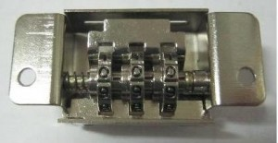
Project scope
In this project, I interfaced the Pic24 and an Arduino using servos to mimic the actions of a locking mechanism.
Using functions and if-Statements, The Servo motors will turn as a 3-digit code is entered by the user. If at any point the code is incorrect, the system will reset to the beginning.

Slide 3

Hardware used
Breadboard with PIC24 (Similar setup from Lab 6)
3 180 degree Servo Motors
3 LEDs (Used for status of locking process)
Various Resistors (To avoid too much current going to LEDs)
Arduino Uno Board

Slide 4
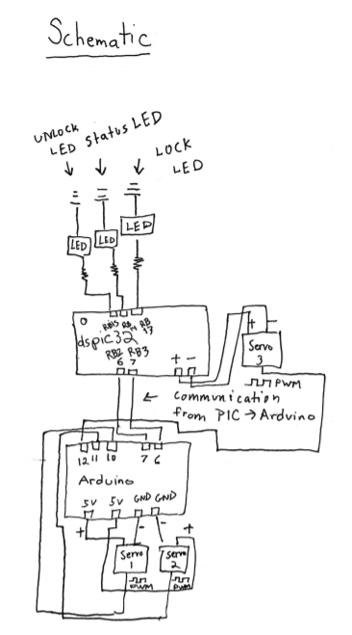
Schematic
The PIC24 was wired exactly like Lab 6. The additional LEDS, resistors, servo motors, and Arduino were added.
1KΩ
1KΩ
1KΩ

Slide 5

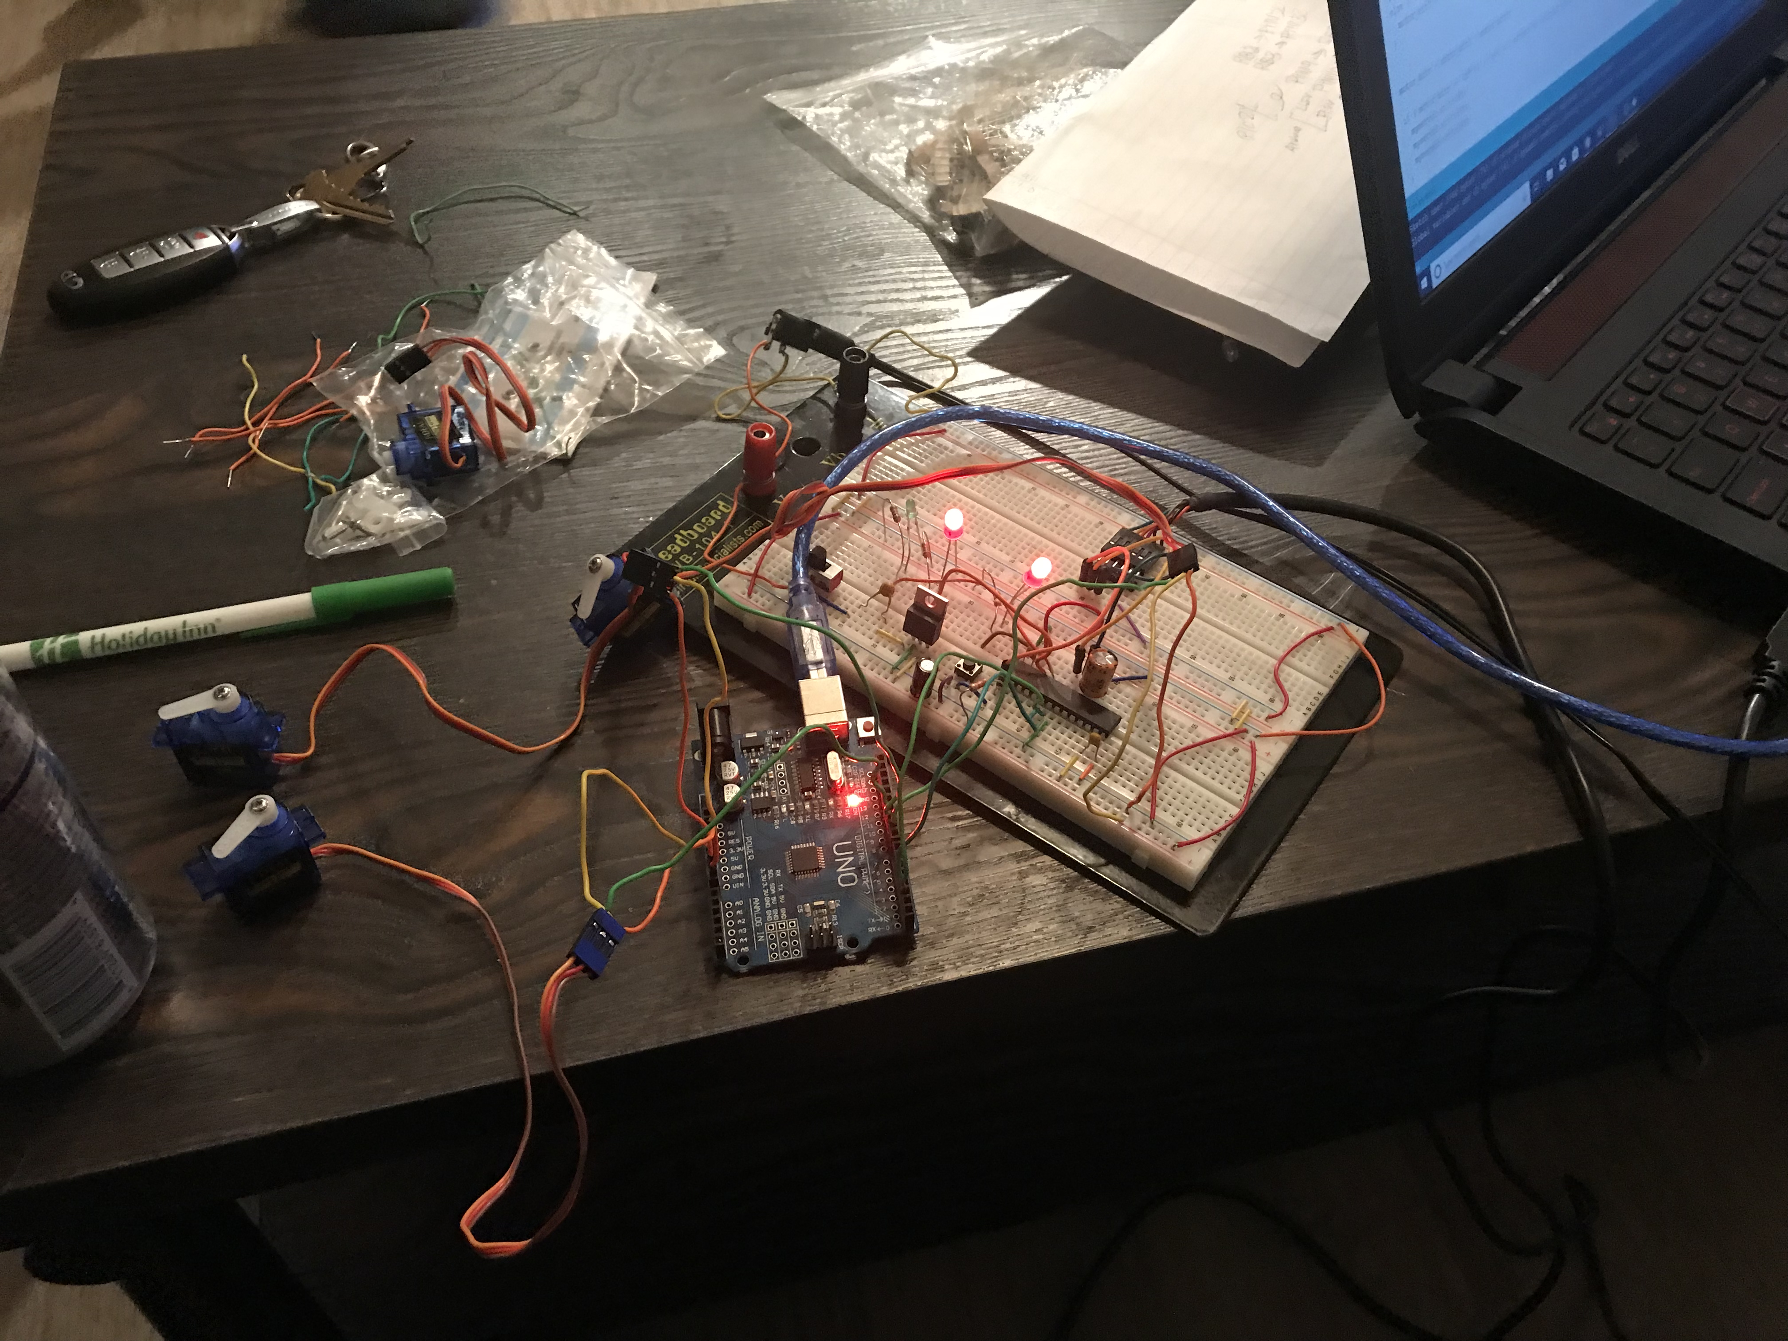
Project photos

